Slide 1
Introduction to Statistical Analysis

Slide 2

Introduction to Statistical Analysis
Introduction
What is Statistics?
The science of collecting, organizing, analysing, and interpreting data.
Why is statistics important?
Helps us make informed decisions from data.
Distinguishes between what seems true and what the evidence shows.

Slide 3
Introduction to Statistical Analysis
Introduction
Every day we face questions like:
Does a new fertilizer really grow taller plants, or is it just luck?
Or when a medicine works in a trial, how do we know it will work for most people?
Statistics gives us the tools to answer these questions, turning raw data into evidence.

Slide 4
Introduction to Statistical Analysis
Learning objectives
By the end of this lecture, students will be able to:
Define statistics and explain why it matters in research and daily life.
Tell the difference between descriptive and inferential statistics.
Identify populations and samples, and explain why we use samples.
Describe types of variables: qualitative (nominal, ordinal) and quantitative (discrete, continuous).
Distinguish between independent and dependent variables.
Calculate and interpret mean, median, and mode.
Calculate and interpret range, variance, and standard deviation.
Show data with histograms and boxplots.
Identify quartiles, median, and outliers in boxplots.
Understand hypothesis testing and its assumptions (t-test, ANOVA).
Perform t-tests, ANOVA, and linear regression.
Interpret p-values and other important results.
Apply post-hoc tests (like Tukey’s HSD) after ANOVA.
Use R to compute statistics and create plots.

Slide 5
Introduction to Statistical Analysis
Lecture overview
Introduction to statistics: what is statistics and why it matters; real-world examples of statistical questions
Populations and samples: difference between populations and samples; why we use samples and types of sampling
Variables: qualitative vs. quantitative; independent vs. dependent variables
Descriptive statistics: measures of central tendency (mean, median, mode); measures of variability (range, variance, standard deviation); visualizing data: histograms and boxplots
Inferential statistics: hypothesis testing and key concepts (p-value, t-statistic, F-statistic, R²); t-tests: one-sample, paired, independent two-sample; ANOVA and post-hoc tests (Tukey’s HSD); linear regression
Using R for analysis: calculating descriptive and inferential statistics; creating plots and interpreting results

Slide 6
Populations and Samples

Slide 7
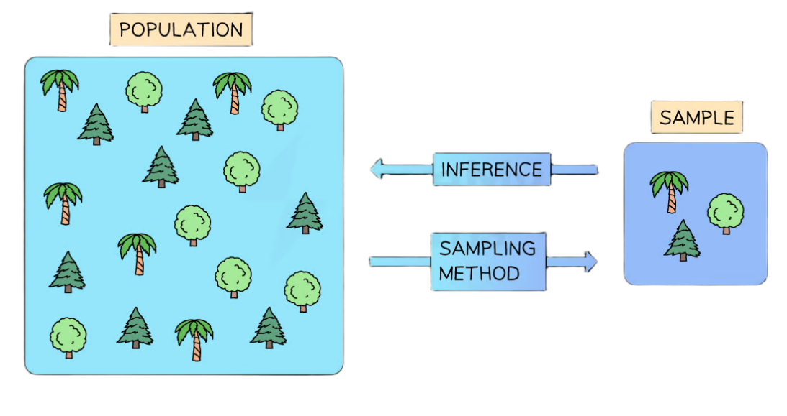
Populations and Samples
Population
The entire group you are interested in studying eg all the trees in the forest
Sample
A subset of the population that you actually collect data from eg. 200 trees randomly selected from different locations

Slide 8
Populations and Samples
Why Use Samples?
Populations are often too large, costly, or impractical to measure fully.
Samples allow us to make inferences about the whole population.
A good sample should be random and representative.
Population vs Sample
Population
Accurate (uses every member/item of the population)
Time-consuming, expensive, large amounts of data to organise and analyse
Sample
Faster, cheaper, manageable
Risk of bias, may not represent the population

Slide 9
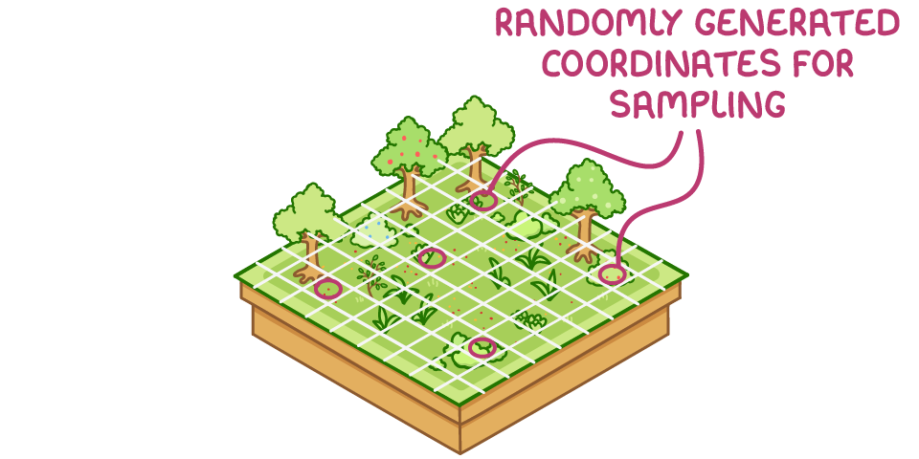

Populations and Samples
Types of Sampling
Random Sampling
Sample points chosen by chance (e.g., random number generator).
Removes researcher bias → all individuals have an equal chance of selection.
Best when population is small or evenly distributed.
Systematic Sampling
Sample points chosen in a regular pattern (e.g., transect sampling).
Easier to apply but risk of bias (e.g., avoiding complex areas).
Can be unrepresentative if the population has hidden patterns.

Slide 10
Variables and Types of Variables

Slide 11
Variables and Types of Variables
What is a variable?
A variable is any characteristic, number, or quantity that can be measured or counted eg. height of plants, number of leaves, type of soil, colour of flowers.

Slide 12
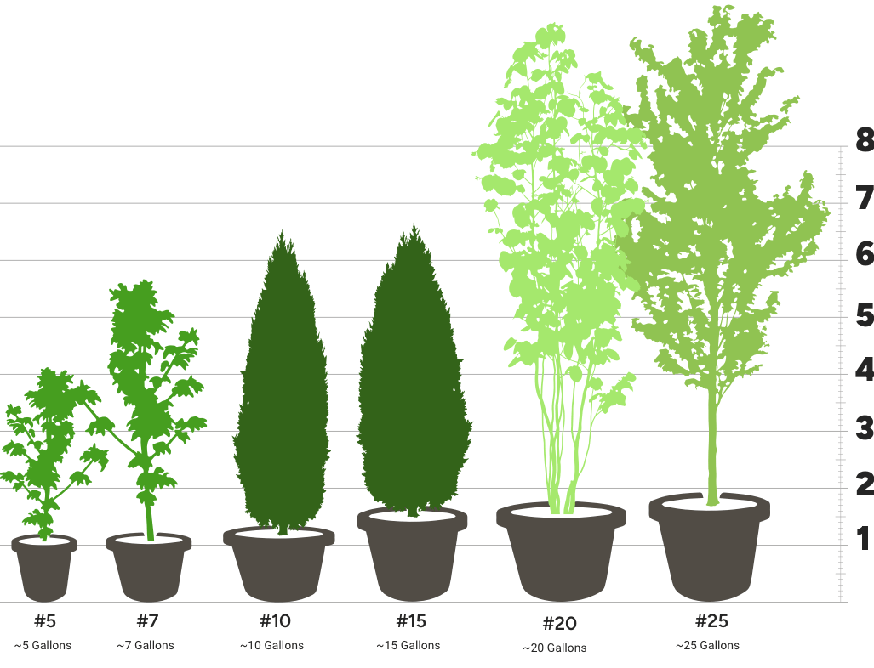
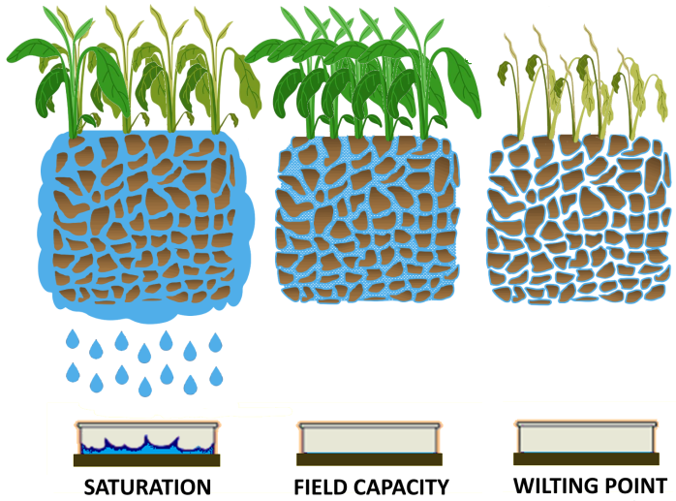

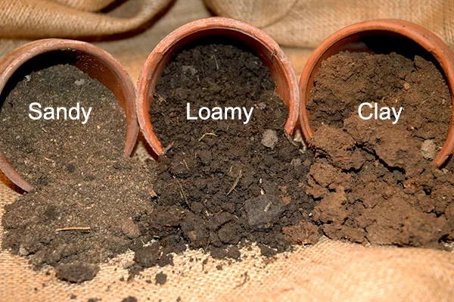
Variables and Types of Variables
Types of variables
Qualitative (categorical) variables that describe qualities or categories.
Nominal: categories with no order eg. eye colour, plant species, soil type.
Ordinal: categories with a meaningful order, but differences are not exact eg. small, medium, large leaf sizes.
Quantitative (numerical) variables are expressed as numbers, can be measured.
Discrete: counted in whole numbers eg. number of petals
Continuous: measured on a scale, can take any value (including decimals) eg. plant height, weight, temperature.
Activity: For each example below, decide what type of variable it is.
plant height
soil type
Number of peas per pod
Water saturation level

Slide 13
Variables and Types of Variables
Dependent vs independent variables
Independent variable: the one you change (cause) eg. amount of fertilizer applied.
Dependent variable: the one you measure (effect) eg. plant height after applying fertilizer.

Slide 14
Descriptive Statistics
plant_measurments_v3.csv

Slide 15
Descriptive Statistics
Descriptive statistics are a way to summarize and describe relatively basic but essential features of a quantitative data set
Provide a snapshot of the characteristics of your data set and allow you to better understand roughly how the data is shaped
Allow you to quickly identify potential issues within your data set for example suspicious outliers, missing responses etc
Allow you to understand the distribution and characteristics of your data before proceeding with inferential analysis

Slide 16
Descriptive Statistics
Types of descriptive statistics
The most common descriptive statistics can be divided into two categories:
Measures of central tendency
Measures of variability

Slide 17
Descriptive Statistics
Measures of central tendency

Slide 18
Descriptive Statistics
Measures of central tendency
Measures of central tendency describe the centre or middle section of a data set
They provide an indication of what a typical data point looks like within a range of numbers
The three most common measures of central tendency are the:
Mean
Median
Mode

Slide 19
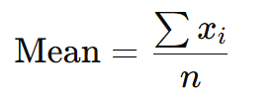
Descriptive Statistics
Measures of central tendency (mean)
Mean is the mathematical average of a set of numbers ie the sum of all the numbers in a range divided by the count of all the numbers in that range
Mean = (Sum of all numbers) ÷ (How many numbers there are)
The mean is sensitive to outliers

Slide 20
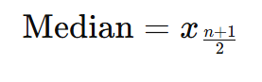
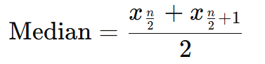
Descriptive Statistics
Measures of central tendency (median)
Median is the middle most number in a range of numbers when those numbers are arranged from lowest to highest
If the number of data points n is odd:
If the number of data points n is even:
The median is resistant to skewness/outliers

Slide 21
Descriptive Statistics
Measures of central tendency (mode)
Mode is the most frequently occurring number in a set of numbers

Slide 22
Descriptive Statistics
Measures of central tendency
Plant heights (cm) = 10, 12, 13, 15, 15, 16, 17, 17, 17, 18, 20, 20, 22, 24
Activity: calculate the mean, median and mode
Mean = ?
Median = ?
Mode = ?
Remember
Mean = (sum of all numbers) ÷ (how many numbers there are)
Median = middle most number in a range of numbers when those numbers are arranged from lowest to highest
Mode = most frequently occurring number in a set of numbers

Slide 23
Descriptive Statistics
Measures of central tendency
Plant heights (cm) = 10, 12, 15, 15, 17, 18, 20, 22, 22, 25
Activity: calculate the mean, median and mode
Mean = ?
Median = ?
Mode = ?
Remember
Mean = (sum of all numbers) ÷ (how many numbers there are)
Median = middle most number in a range of numbers when those numbers are arranged from lowest to highest
Mode = most frequently occurring number in a set of numbers

Slide 24
Descriptive Statistics
Histograms
We can visualize the mean, median, and mode on a histogram.
A histogram is a graph that shows how data is distributed:
The x-axis (horizontal) is divided into intervals or bins (e.g., plant height ranges: 10-11, 12-13, 14-15, etc.)
The y-axis (vertical) shows how many data points fall into each bin (the frequency)
Each bar represents the number (or proportion) of values within that range
This makes it easy to see patterns in the data, such as where most values cluster, and how the mean, median, and mode compare.

Slide 25
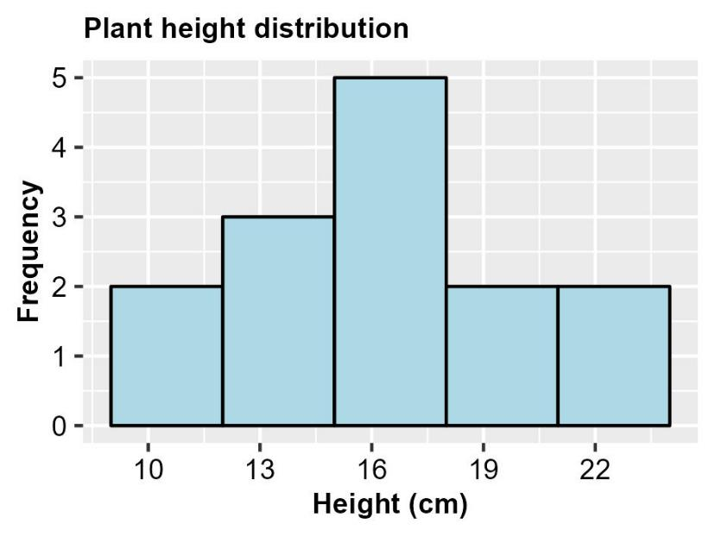
Descriptive Statistics
Histograms
Plant heights (cm) = 10, 12, 13, 15, 15, 16, 17, 17, 17, 18, 20, 20, 22, 24
Frequency table
Plant heights (cm) | Frequency
10-12 | 2
13-15 | 3
16-18 | 5
19-21 | 2
22-24 | 2

Slide 26
Descriptive Statistics
Histograms
Plant heights (cm) = 10, 12, 15, 16, 17, 17, 20, 20, 22, 24, 25
Activity: construct a frequency table and draw a histogram

Slide 27






Statistical Software
Are there any software can you use to calculate mean, median, and mode?
There are lots of options!
Commercial packages: SPSS, NCSS, XLSTAT, and Minitab all have built-in tools for descriptive statistics.
Free & open-source: R (with RStudio) is a powerful, flexible option that’s widely used in research and teaching.
Commercial packages- expensive, limited capabilities
Open-source package- free, powerful, flexible

Slide 28


R Statistical Software
R is a free, open-source programming language for statistics, data analysis, and visualization.
It is widely used in research, academia, and industry to handle data of all sizes.
You can calculate anything from simple mean, median, and mode, to advanced statistical models and machine learning.
Because it is open-source, there is a large community with lots of packages for almost any type of analysis.
You!!!
R- open-source, free, powerful, flexible tool

Slide 29
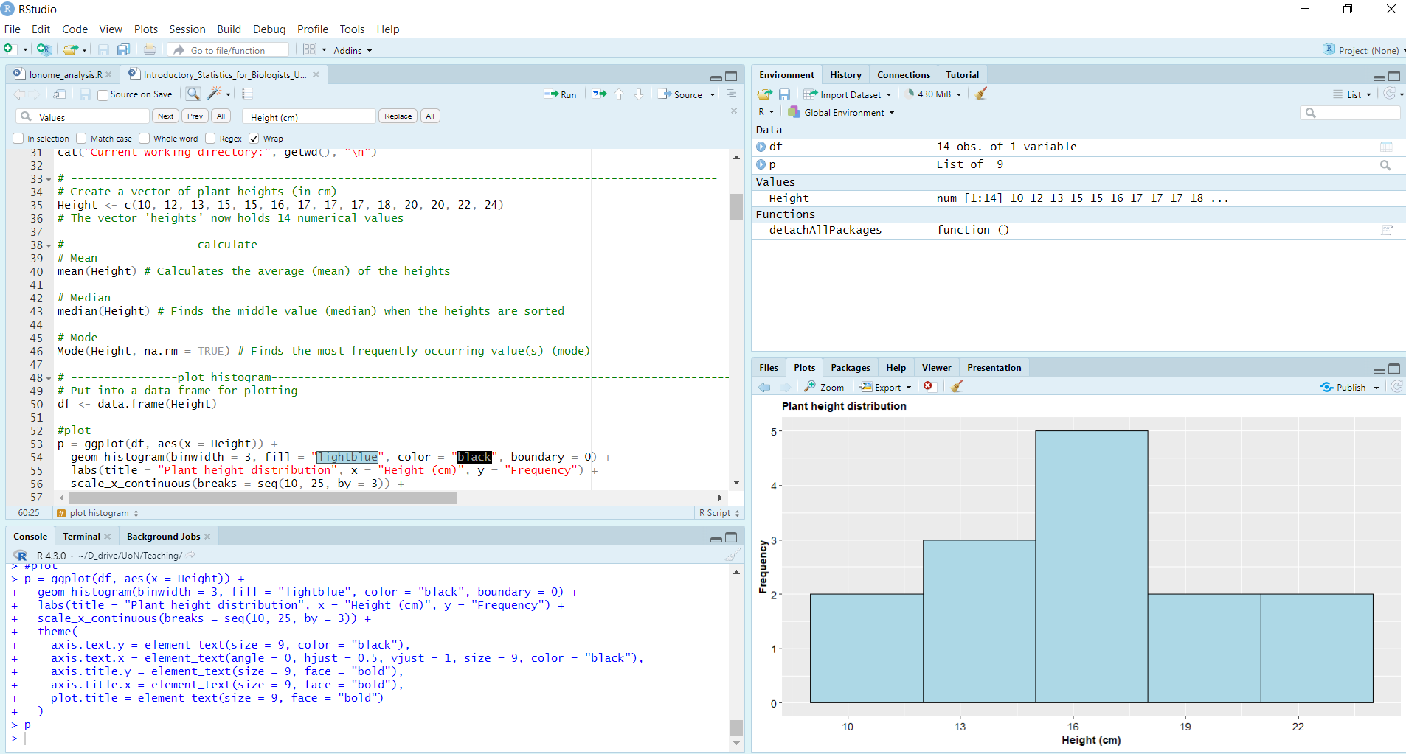
RStudio
RStudio is a user-friendly interface for R that makes coding, data visualization, and project management easier.
It provides helpful features like:
A script editor to write and save R code
Console to run commands immediately
Environment to view variables and data
Plots pane to visualize charts and graphs
Script editor
Environment
Console
Plots pane

Slide 30
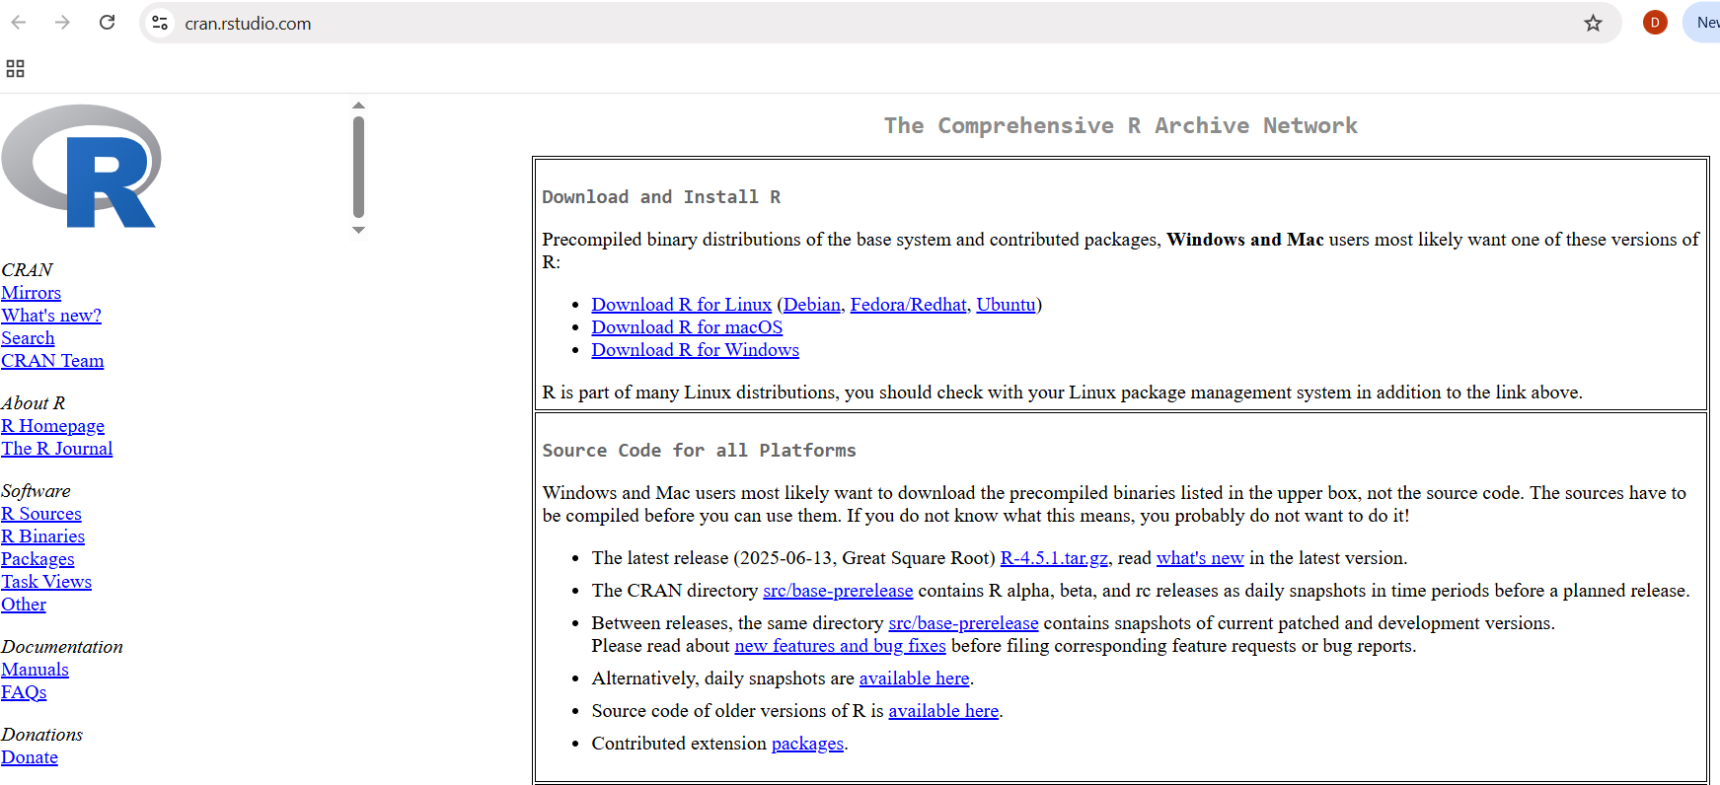
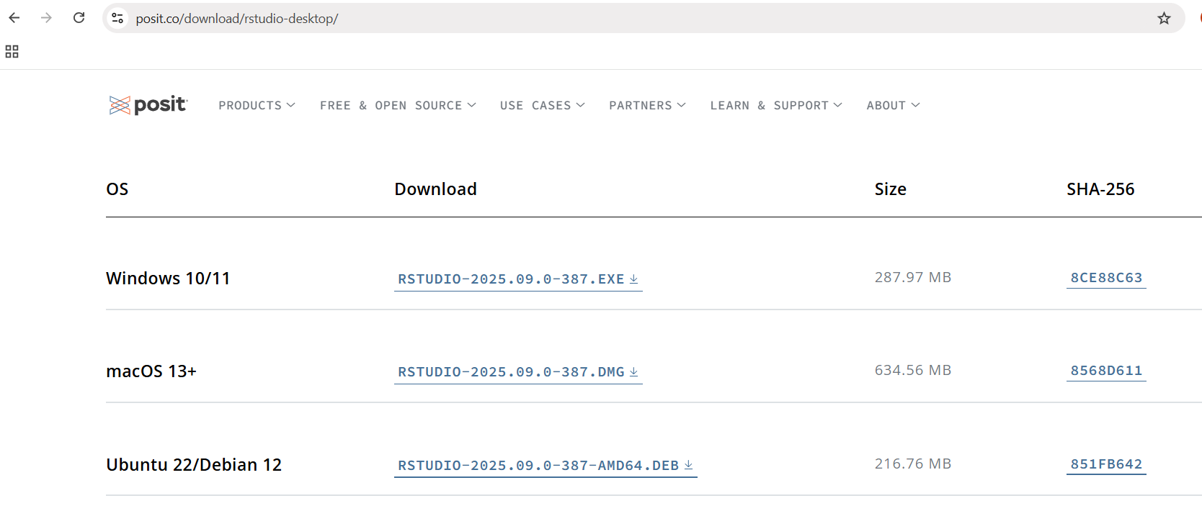
Downloading and Installing R & RStudio
https://cran.rstudio.com/
https://posit.co/download/rstudio-desktop/

Slide 31
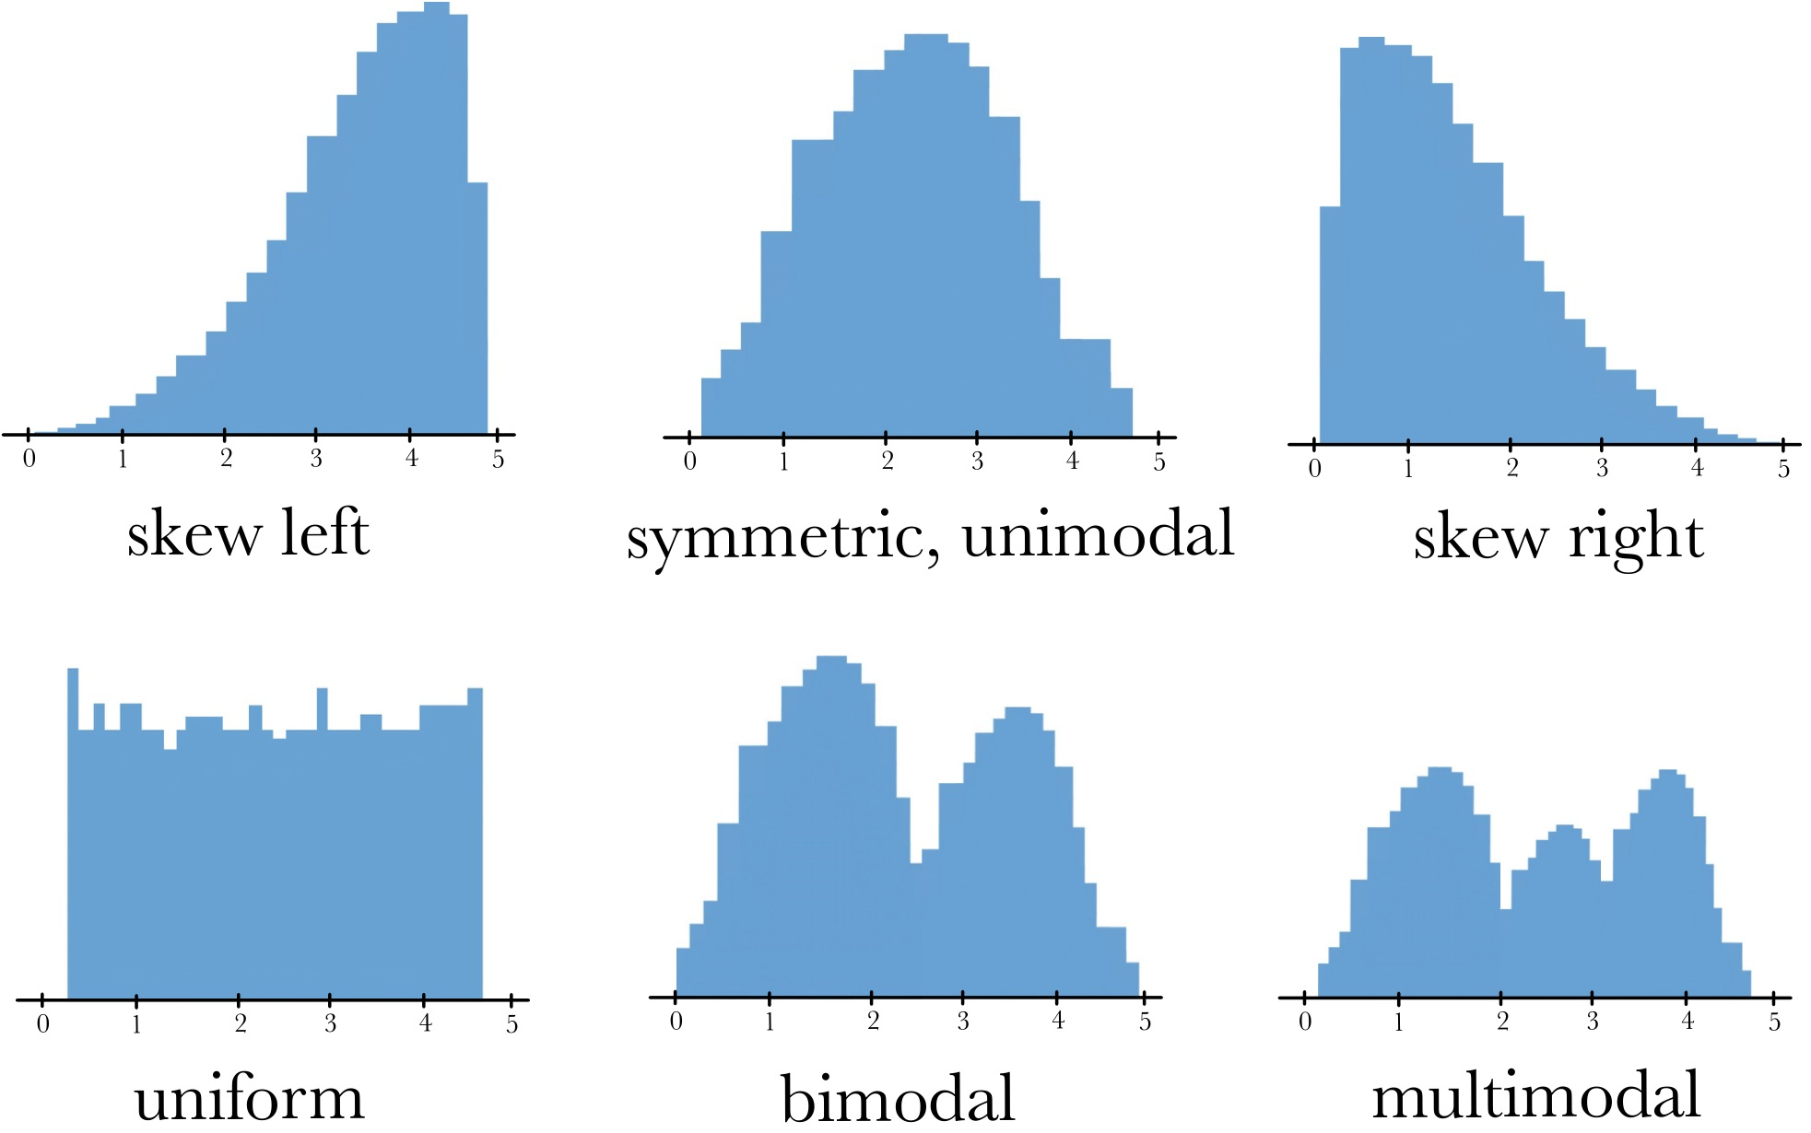
Shape of Distribution

Slide 32
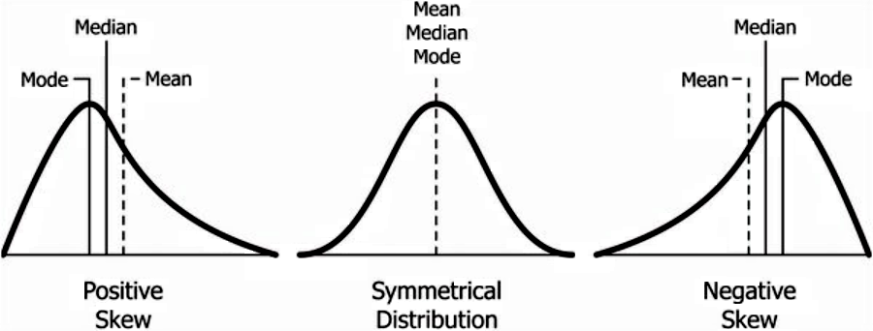
Shape of Distribution

Slide 33
Descriptive Statistics
Measures of variability

Slide 34
Descriptive Statistics
Measures of variability
While mean, median, and mode tell us about the centre of the data, measures of variability tell us how spread out the data is.
The three most common measures of variability are the:
Range
Variance
Standard Deviation

Slide 35
Descriptive Statistics
Measures of variability (Range)
The range is the difference between the largest and smallest value.
Advantages: simple and quick to calculate.
Disadvantages: relies on only two data points, ignoring the rest of the dataset; highly sensitive to outliers; provides no information about the overall shape or distribution of the data.
Range = Max value – Min value

Slide 36
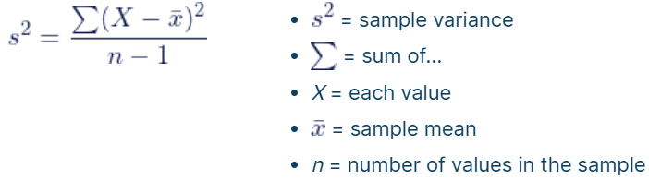
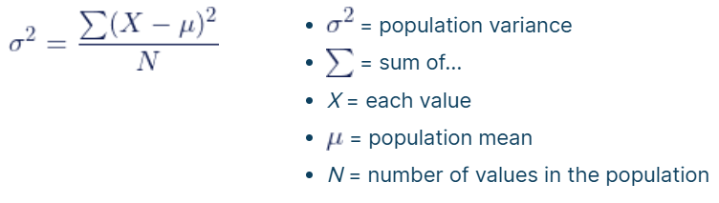
Descriptive Statistics
Measures of variability (Variance)
The variance is the average of the squared differences from the mean.
Step 1: Find the mean
Step 2: Find each value’s difference from the mean
Step 3: Square each difference from the mean
Step 4: Find the sum of squares
Step 5: Divide the sum of squares by n – 1 or N
Interpretation: Show data clustered tightly (small variance) vs spread out (large variance).
Sample variance
Population variance

Slide 37
Descriptive Statistics
Measures of variability (Variance)
Plant heights (cm) = 10, 12, 15, 18, 22
Activity: calculate the variance
Step 1: Find the mean = ?
Step 2: Find each value’s difference from the mean = ?
Step 3: Square each difference from the mean = ?
Step 4: Find the sum of squares = ?
Step 5: Divide the sum of squares by n – 1 = ?
Sample variance

Slide 38
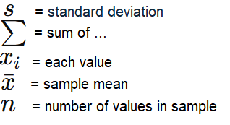
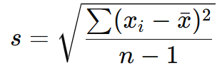
Descriptive statistics
Measures of variability (Standard Deviation)
The standard deviation is the square root of the variance.
Expressed in the same units as the data (unlike variance, which is in squared units).
Both variance and standard deviation measure variability, but in different units: standard deviation uses the same units as the data (e.g., cm), while variance uses squared units (e.g., cm squared), making it less intuitive.
Standard deviation is easier to interpret, but variance is more informative for statistical inferences.

Slide 39
Quartiles in Statistics

Slide 40
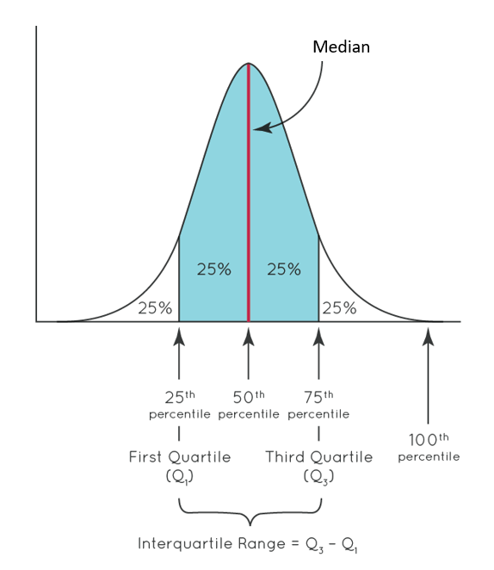
Descriptive Statistics
Quartiles in statistics
Quartiles divide a dataset into four equal parts, each containing 25% of the observations:
Q1 (25th percentile): 25% of the data falls below this value.
Q2 (50th percentile / median): 50% of the data falls below this value.
Q3 (75th percentile): 75% of the data falls below this value.
How to Find Quartiles
Order the data: Arrange the dataset from smallest to largest.
Find the median (Q2): Identify the middle value of the ordered data.
Find Q1: Determine the median of the lower half of the data (values below Q2).
Find Q3: Determine the median of the upper half of the data (values above Q2).

Slide 41
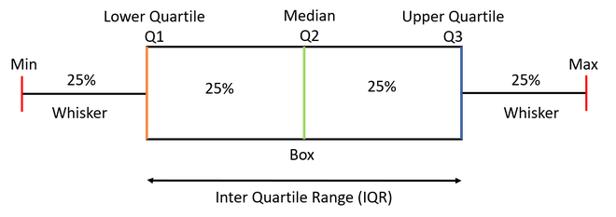
Descriptive Statistics
Histogram
Quartiles in statistics
Why determine quartiles?
They help describe the distribution and variability of data.
Together with the minimum and maximum, Q1, Q2, and Q3 form the five-number summary.
The Interquartile Range (IQR = Q3 – Q1) measures the spread of the middle 50% of the data and is useful for identifying potential outliers.
Boxplot

Slide 42
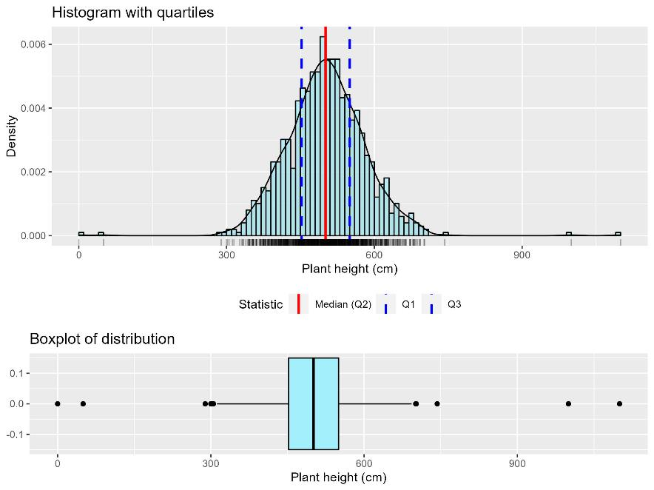
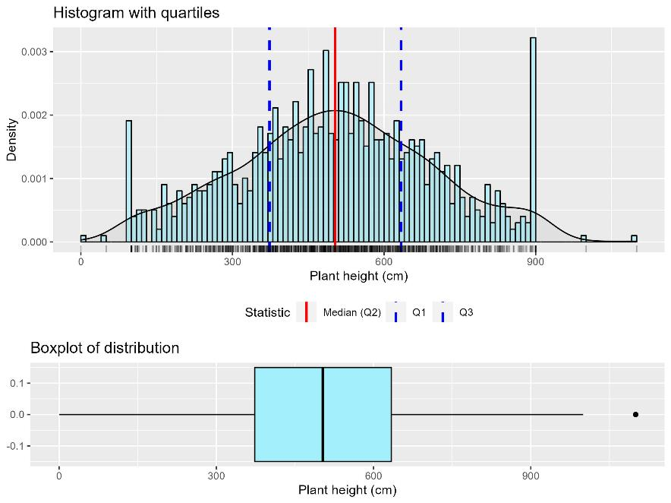
Descriptive Statistics
Quartiles in statistics
Narrow histogram
Shows low variability.
Most data points cluster closely around the mean.
The distribution looks tall and tight.
Wide histogram
Shows high variability.
Data points are more spread out from the mean.
The distribution looks flatter and stretched.

Slide 43
Inferential Statistics

Slide 44
Descriptive vs Inferential Statistics
Descriptive statistics summarize and describe the key features of a quantitative dataset. They provide a snapshot of the data’s characteristics, helping you understand its centre, spread, and overall shape. Descriptive statistics describe and summarize the data within a sample.
Inferential statistics use sample data to make predictions or draw conclusions about a larger population. While descriptive statistics help you understand your sample, inferential statistics allow you to make broader statements and generalizations based on that sample.

Slide 45
Inferential Statistics
Common inferential statistics:
Hypothesis testing (e.g., t-test, chi-square): are differences between groups real or just due to chance?
Confidence intervals: a range of values likely to contain the true population parameter.
Regression / correlation: predicting or examining relationships between variables.

Slide 46
t-test

Slide 47
Inferential Statistics
t-test
A t-test is a statistical test used to determine if there is a significant difference between the means of two groups
Key points
Null hypothesis (H₀): There is no real difference between means.
Alternative hypothesis (H₁): There is a difference.
t-statistic: Measures how far the sample mean is from the null hypothesis, relative to variability.
p-value: Probability of observing your result (or more extreme) if H₀ is true.
Null hypothesis is rejected if p-value < 0.05. This means the observed differences are unlikely to be due to chance alone and are considered statistically significant.

Slide 48
Inferential Statistics
t-test
Main assumptions
The dependent variable should be continuous (interval or ratio scale, e.g., height, weight, scores).
Observations should be independent and collected from a random sample of the population. No relationship between the values in one group and the values in another (except in a paired t-test, where pairs are related).
The data in each group should be approximately normally distributed
The variances in the two groups should be equal for independent two-sample t-test. If not, Welch’s t-test is preferred (it adjusts for unequal variances).
Types of t-tests
One-sample t-test: Compares the mean of a sample to a known value (e.g., is the average height of these plants different from 10 cm?)
Paired sample t-test: Compares means from the same group at two times (eg. before vs. after an intervention)
Independent two-sample t-test: Compares means from two independent groups (e.g., average plant height with fertilizer A vs fertilizer B).

Slide 49
ANOVA (Analysis of Variance)

Slide 50
Inferential Statistics
ANOVA
ANOVA tests whether the means of three or more groups are significantly different.
Use it when you have:
One continuous dependent variable (e.g., plant height).
One categorical independent variable with three or more groups (e.g., fertilizer type: Control, A, B).
Example: Compare average plant heights under three treatments- Control, Fertilizer A, and Fertilizer B.
Key Points
Null hypothesis (H₀): All group means are equal.
Alternative hypothesis (H₁): At least one group mean is different.
F-statistic: A ratio of variability between groups to variability within groups.
A large F-statistic suggests stronger evidence that not all group means are equal.
p-value: The probability of observing the data (or something more extreme) if H₀ is true.
If p-value < 0.05, reject H₀. This means the observed differences in means are unlikely to be due to chance alone and are considered statistically significant.

Slide 51
Inferential Statistics
ANOVA
Main assumptions
Each data point should be collected independently of the others
The data within each group should be approximately normally distributed (this can be checked with Shapiro-Wilk normality test; ANOVA is robust to mild deviations from normality)
The variance of the dependent variable should be roughly equal across all groups (this can be checked with Levene’s test)
Post-hoc test
ANOVA only tells you that a difference exists- not which groups differ.
Use Tukey’s HSD or similar tests to find pairwise differences.

Slide 52
Linear Regression

Slide 53
Inferential Statistics
Linear regression
Linear regression is a method to model the relationship between two variables:
Independent variable (x) – predictor / cause
Dependent variable (y) – response / effect
The goal: predict y from x and understand how y changes when x changes.
The relationship is expressed as:
Where:
Intercept = value of y when x = 0
Slope = change in y for a one-unit change in x
Error = difference between observed and predicted y

Slide 54
Inferential Statistics
Linear regression
Assumptions
Relationship between x and y is linear.
Observations are independent of each other.
Constant variance of residuals across all levels of x.
Residuals (differences between observed and predicted y) are roughly normally distributed.

Slide 55
Inferential Statistics
Linear regression
Example / Application
A calibration curve is a practical application of linear regression:
x-axis: known standard values (e.g., concentration)
y-axis: measured response (e.g., absorbance)
It allows you to estimate unknown values by interpolating from the regression line.
Common examples: plant pigment concentration, spectrophotometry absorbance, enzyme activity.
Interpreting the regression line (calibration curve)
Slope: Indicates how much the measured response changes for each unit increase in concentration.
Positive slope → response increases as concentration increases.
Intercept: Predicted response when the concentration is zero.
Represents the baseline reading (e.g., blank measurement).
R² (coefficient of determination): Proportion of variability in the response that is explained by the concentration.
Values range from 0 to 1; higher values indicate a better fit of the line to the data.
p-value: Tests whether the slope is significantly different from zero.
A small p-value (e.g., < 0.05) means the concentration has a statistically significant effect on the response.

Slide 56
Introduction to Statistical Analysis
Key Takeaways
Statistics helps us make sense of data - it turns raw numbers into meaningful information for decision-making.
Descriptive vs. inferential statistics - describe your sample vs. make conclusions about a population.
Populations and samples - understanding sampling is essential to avoid bias.
Variables - know the types (qualitative/quantitative, independent/dependent) to choose the right analysis.
Descriptive statistics - mean, median, mode, range, variance, SD, quartiles, IQR; visualize with histograms and boxplots.
Inferential statistics - t-tests and ANOVA test hypotheses, linear regression; p-values, t-statistics, F-statistics, R² guide interpretation.
Post-hoc tests (Tukey’s HSD) - identify which groups differ after a significant ANOVA.
Using R - a practical tool for calculating statistics and creating visualizations.
Alignment with learning objectives: Students can now define key concepts, differentiate statistics types, calculate and interpret descriptive measures, perform basic hypothesis tests, and visualize data in R.

Slide 57
Useful Resources
Statistical Analysis
https://www.youtube.com/watch?v=SplCk-t1BeA
https://www.youtube.com/watch?v=FzujIYo9GYo
https://www.youtube.com/watch?v=dYJLUvo0Q6g
https://www.scribbr.co.uk/category/stats/
Installing R and RStudio
https://www.youtube.com/watch?v=TsnGd6p9oTk
Creating Files & Touring RStudio
https://rladiessydney.org/courses/01-basicbasics-1
Installing and Loading Packages
https://rladiessydney.org/courses/01-basicbasics-2
Importing & Exploring Data in R
https://rladiessydney.org/courses/01-basicbasics-3

Slide 58
R resources and activities
Measures of Central Tendency: Introduction to Statistical Analysis- Measures of Central Tendency.R
Measures of Variability: Introduction to Statistical Analysis- Measures of Variability.R
Quartiles in statistics: Introduction to Statistical Analysis- Quartiles.R
t-test: Introduction to Statistical Analysis- t-test.R
ANOVA: Introduction to Statistical Analysis- ANOVA.R
Linear Regression: Introduction to Statistical Analysis-Linear Regression.R
Example dataset: plant_measurments_v3.csv

